Slide 1


Game ON
Team Members (Project Group-16):
Golla Ranga Kousik - 16322459
Nagula Ajay Kumar - 16327661
Mamjala Manisha - 16307984
Chenna Srinivas - 16307995

Slide 2
Introduction:
Game ON is a holistic Sports Application which helps to bring back Play in everyone’s lifestyle. It is a web application through which these group of people can book a playing venue or create an activity in their preferred location as per their interest so that the others like him can join him. Our primary agenda is to generate a playfield in which you can fit in with other fellow playpals.
Goals and Objectives:
Our primary goal is to establish connections by making new playpals, organizing playgroups, sharing the information or the experiences, discovering the sporting venues activities and lending sport items.

Slide 3
Key Features:
Book a Sports Venue
Create an activity
Blog (Articles)
Lending sport equipment

Slide 4

Home Page
Contains 4 navigations
Book Venues
Activities
Blog
Lend

Slide 5

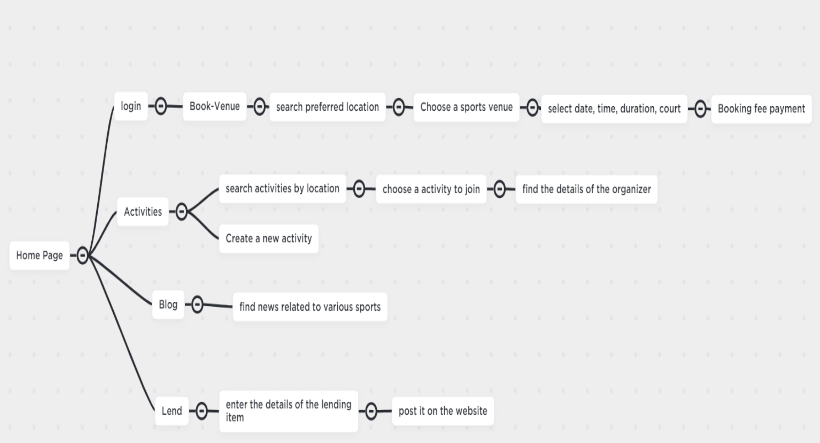
Website Flow:

Slide 6
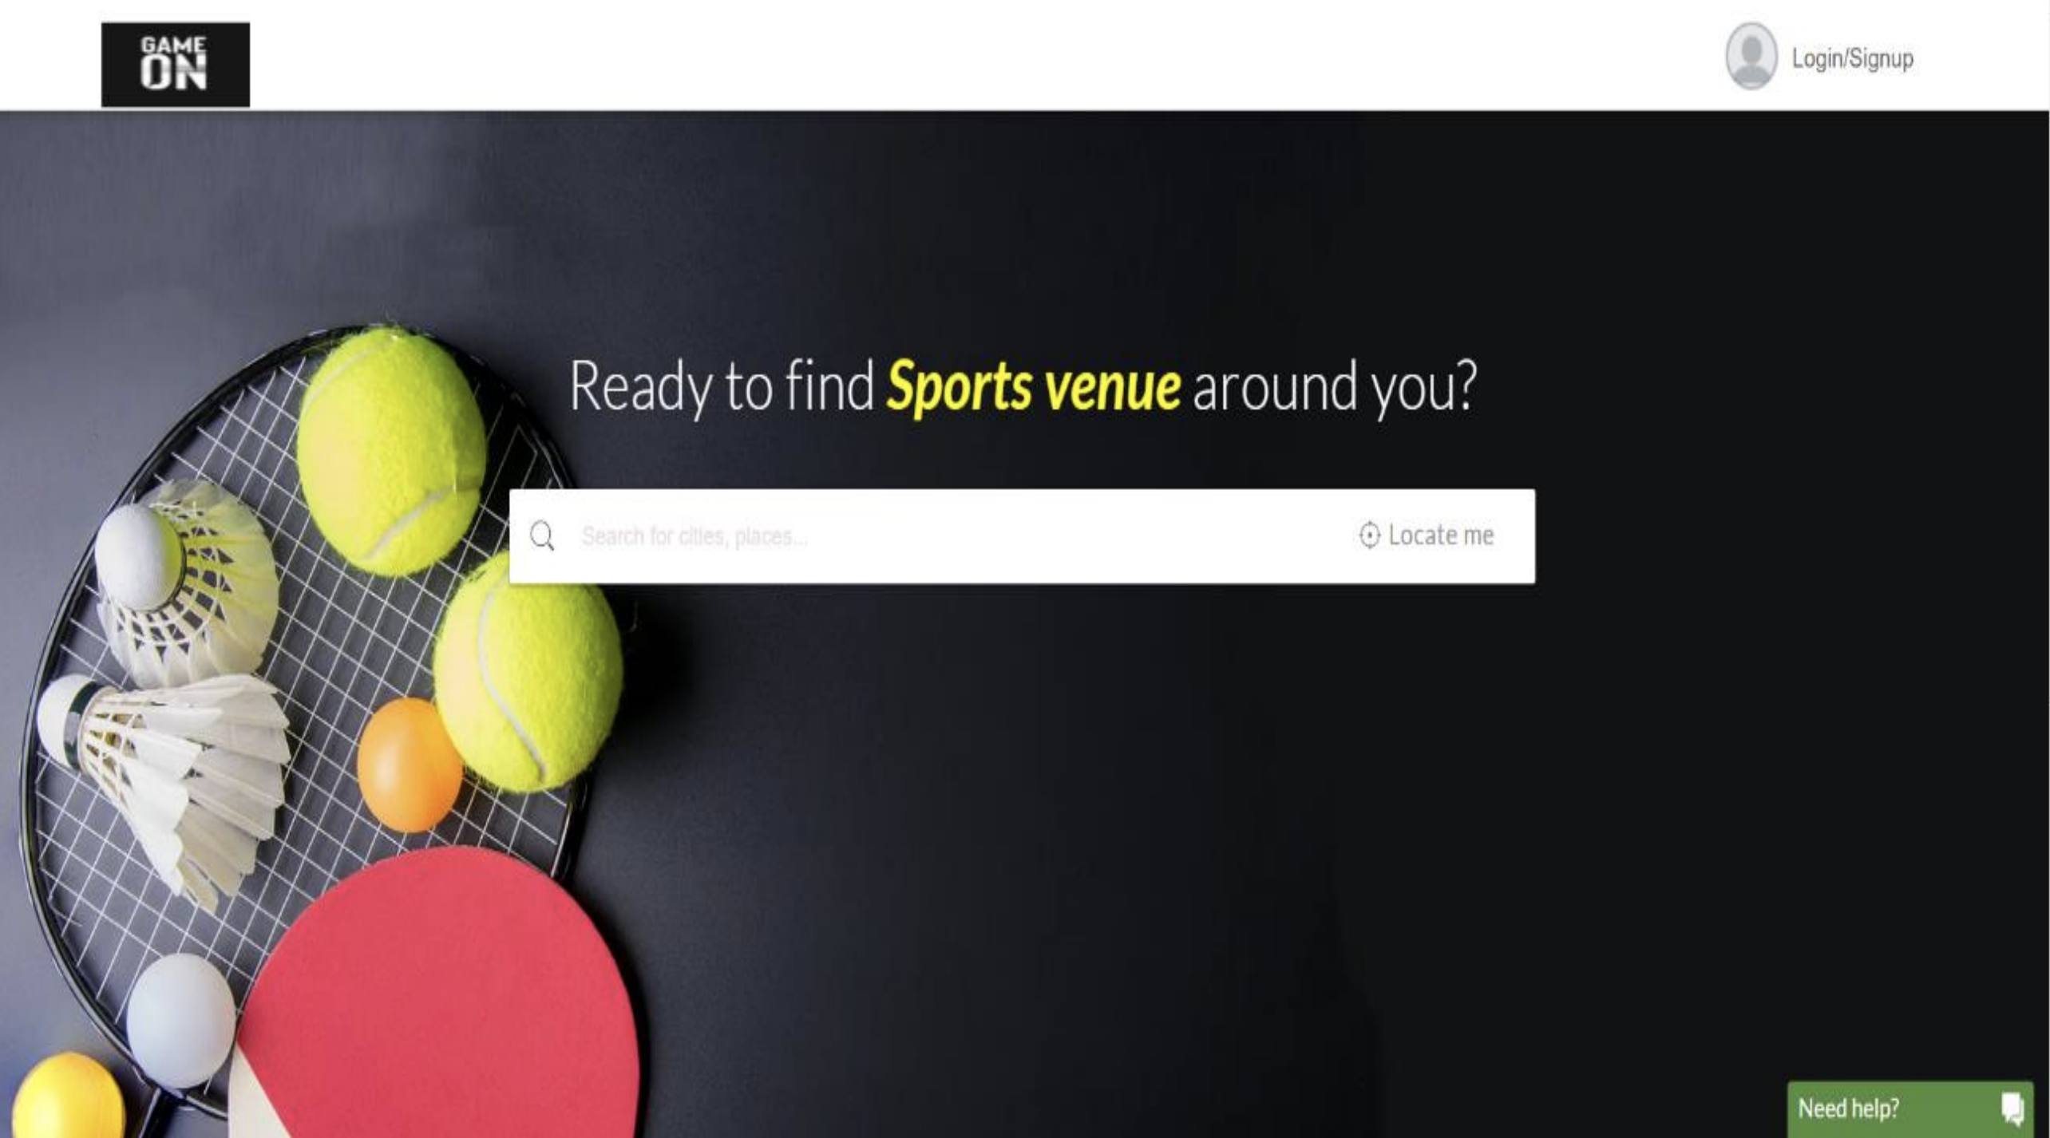
Book Venues
User can find the nearby venues by passing the location information
debounce function

Slide 7
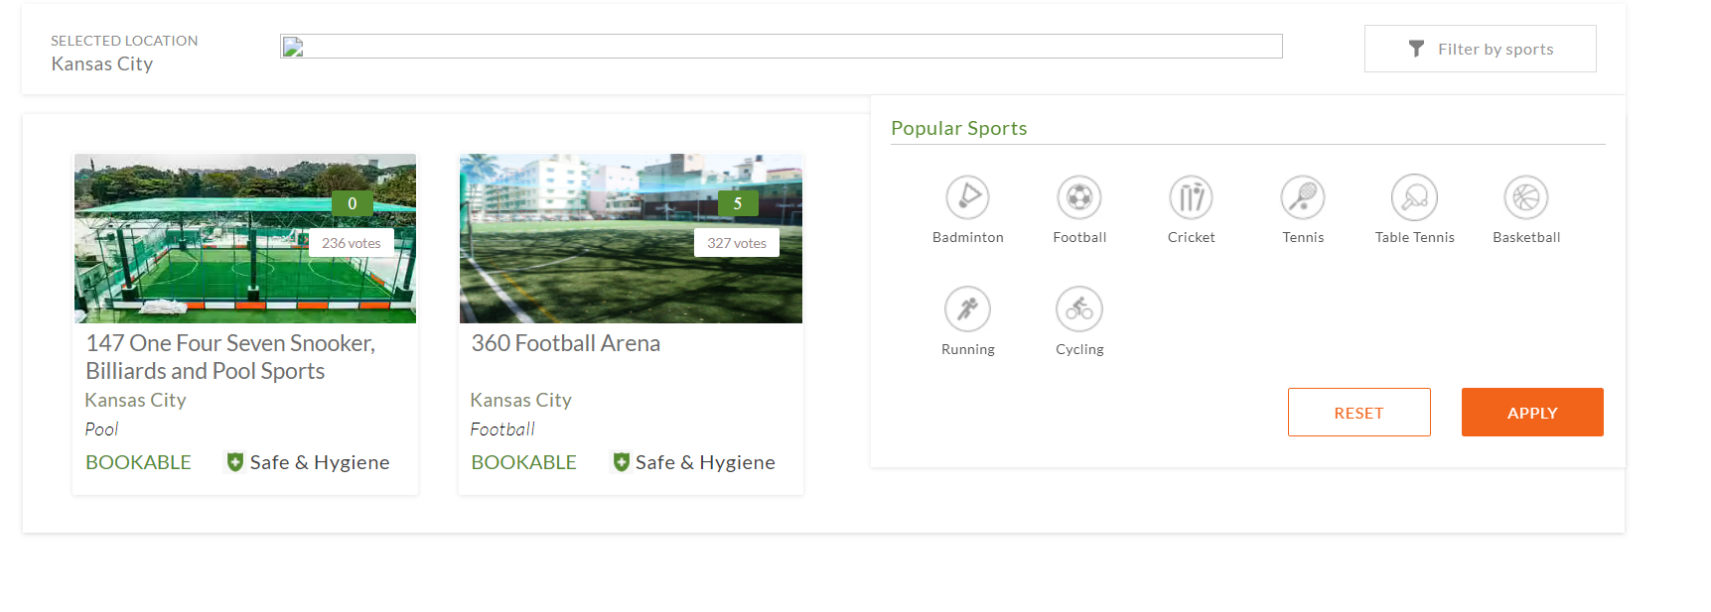
RegExp gi Modifier: The gi modifier is used to do a case insensitive search of all occurrences of a regular expression in a string.

Slide 8
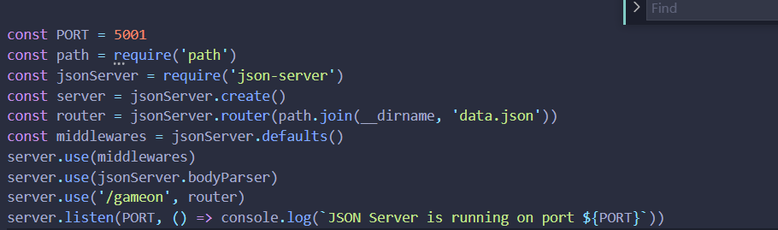
JSON server:JSON Server is a Node Module that you can use to create demo rest Json webservice in less than a minute.

Slide 9
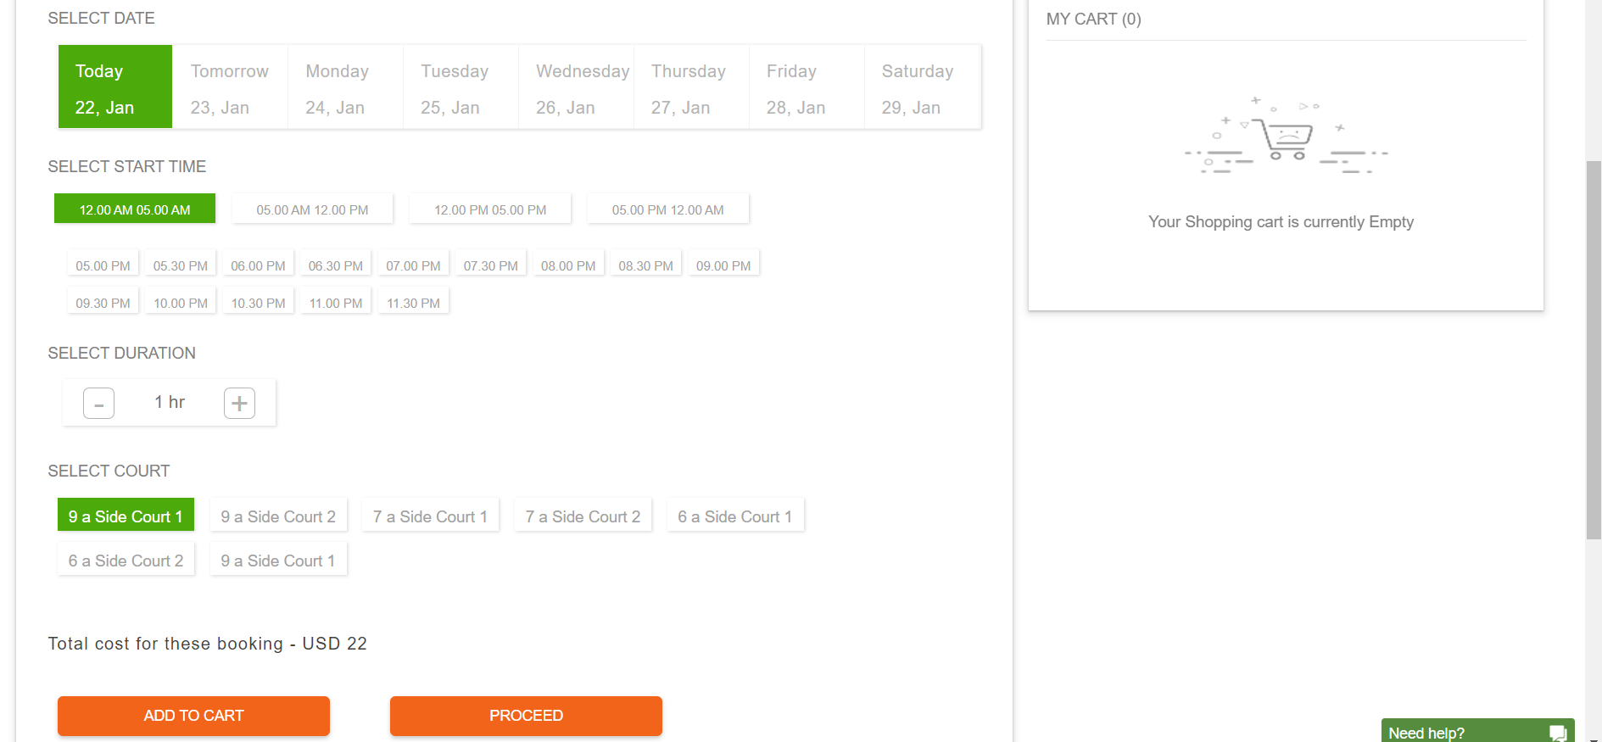
Booking Venue

Slide 10
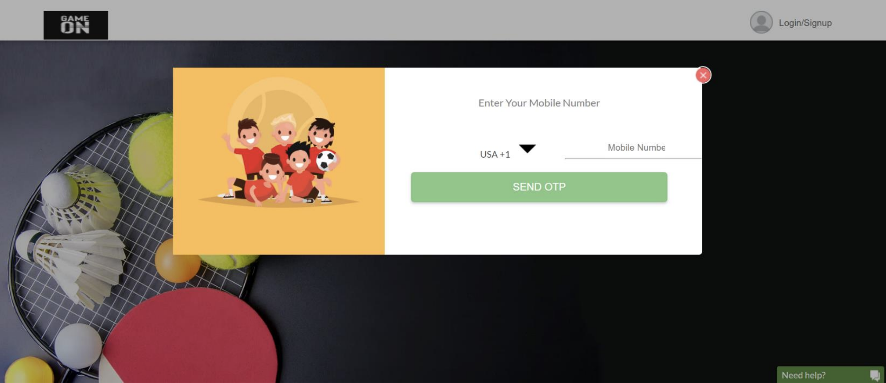
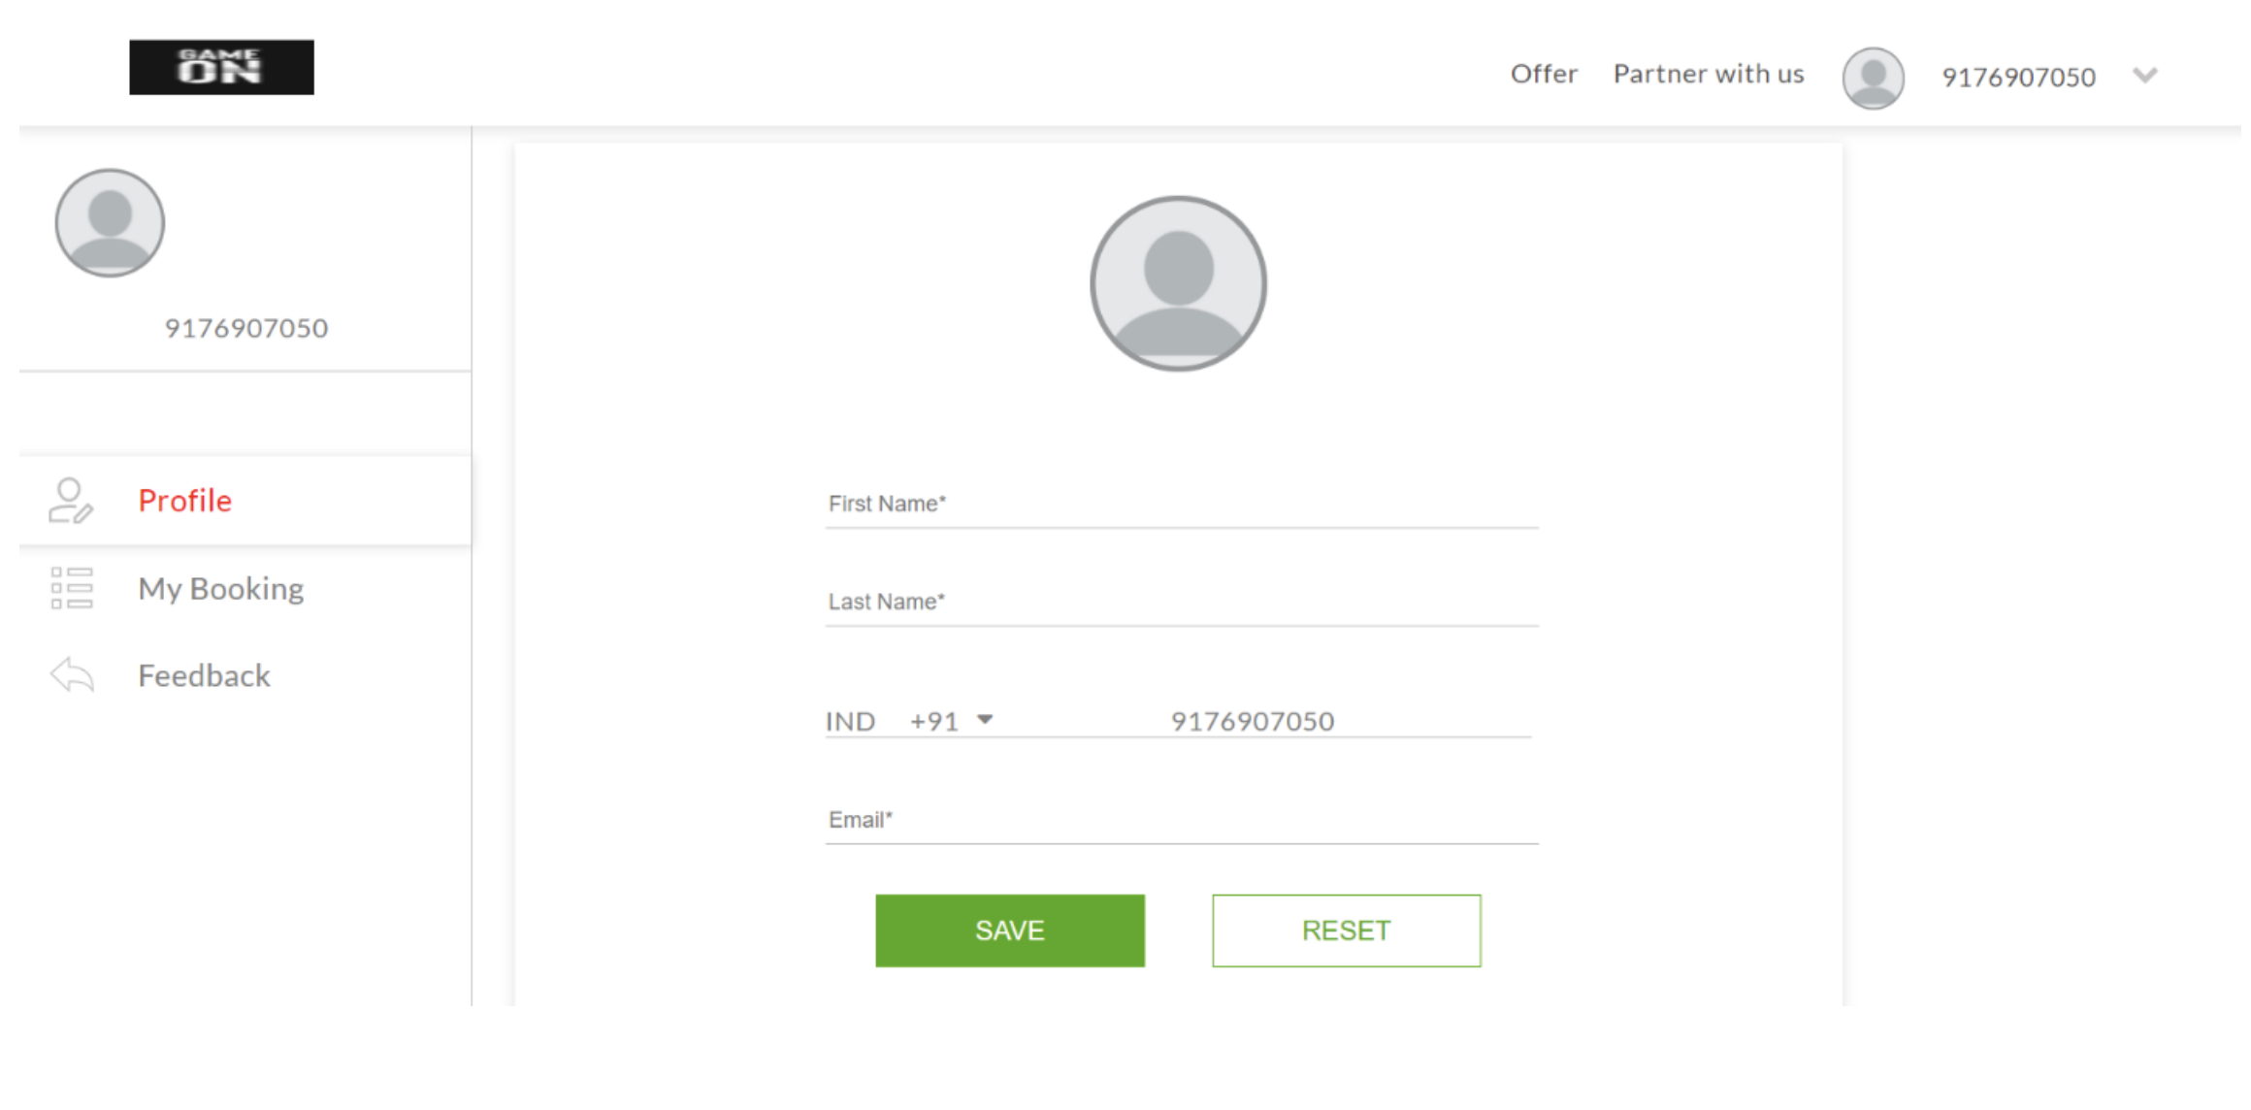
Login/SignUp
Profile Information

Slide 11
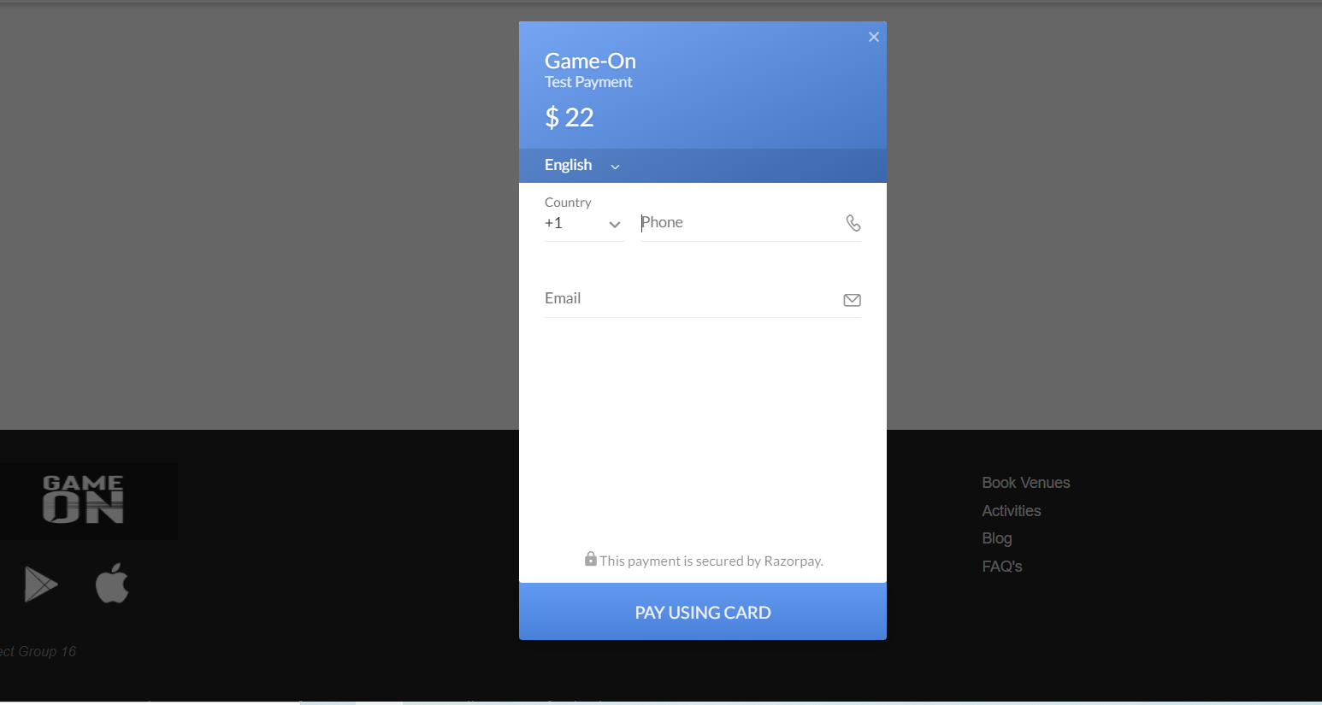
Payment
Used razor pay gateway

Slide 12
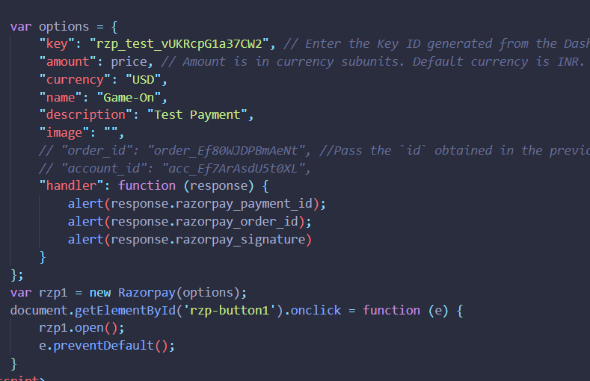
Payment

Slide 13
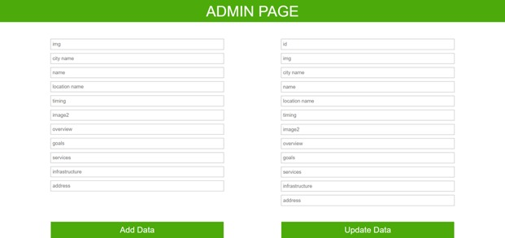

Slide 14
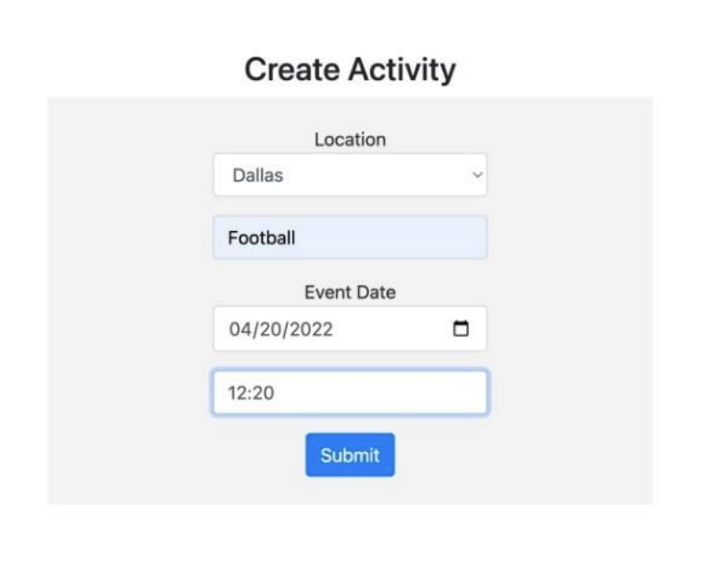
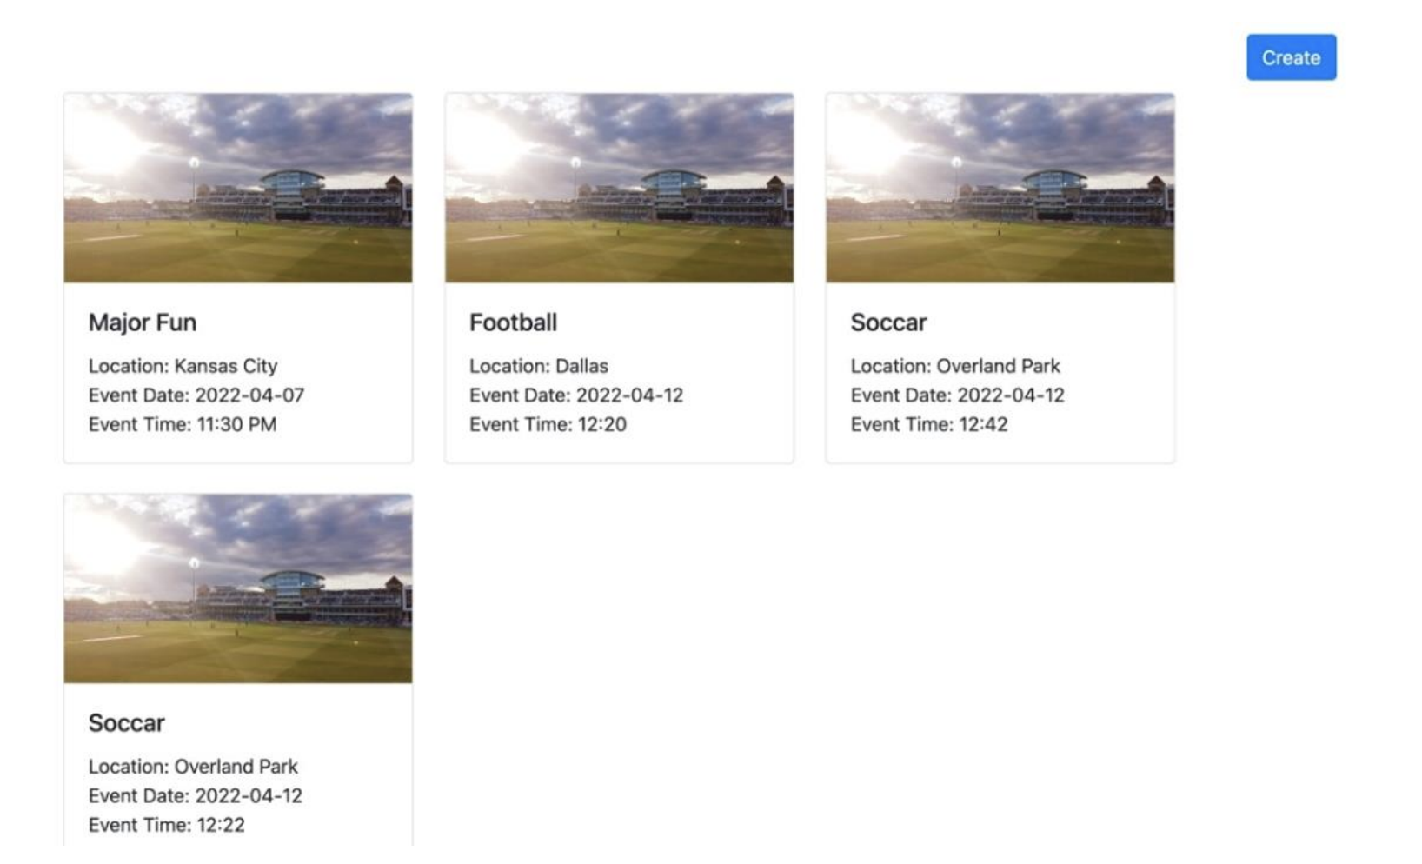
Creating an Activity

Slide 15
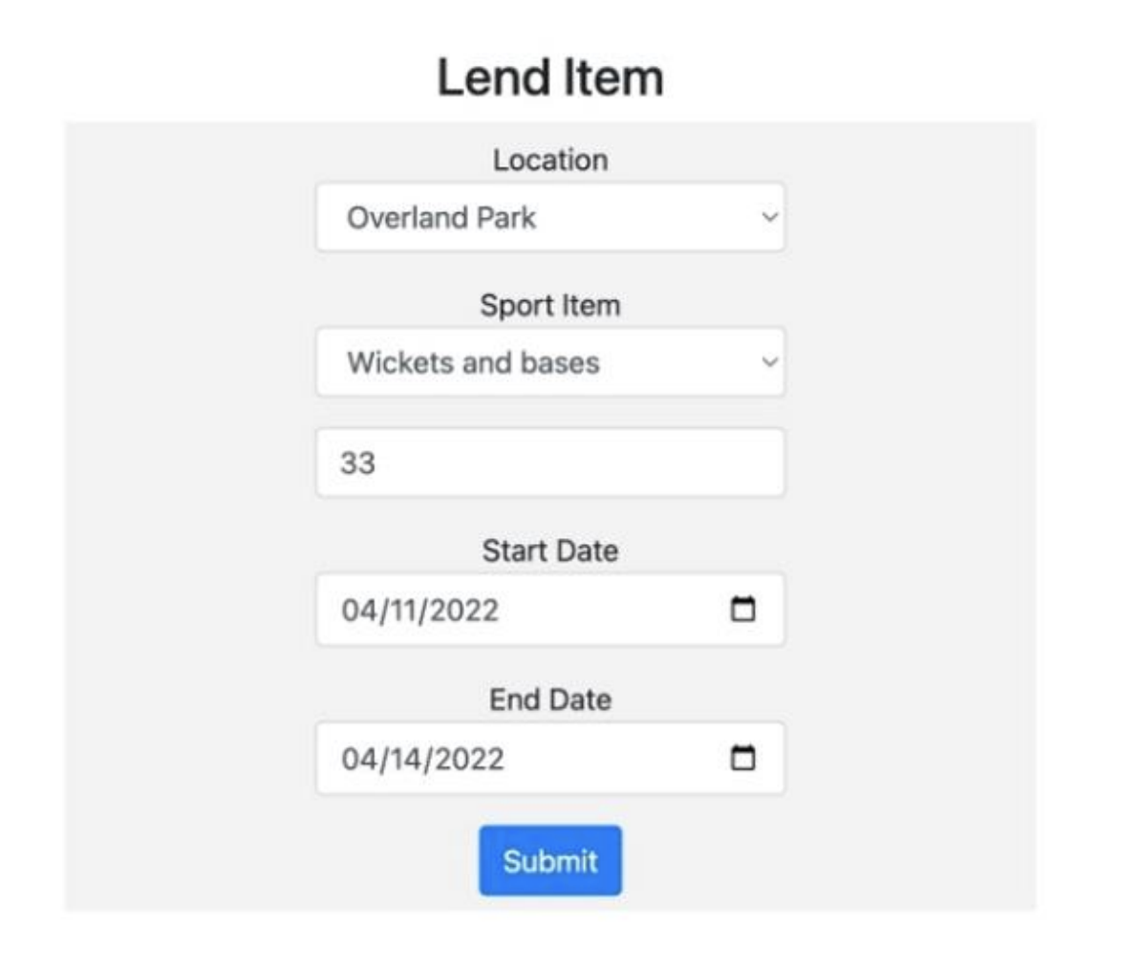
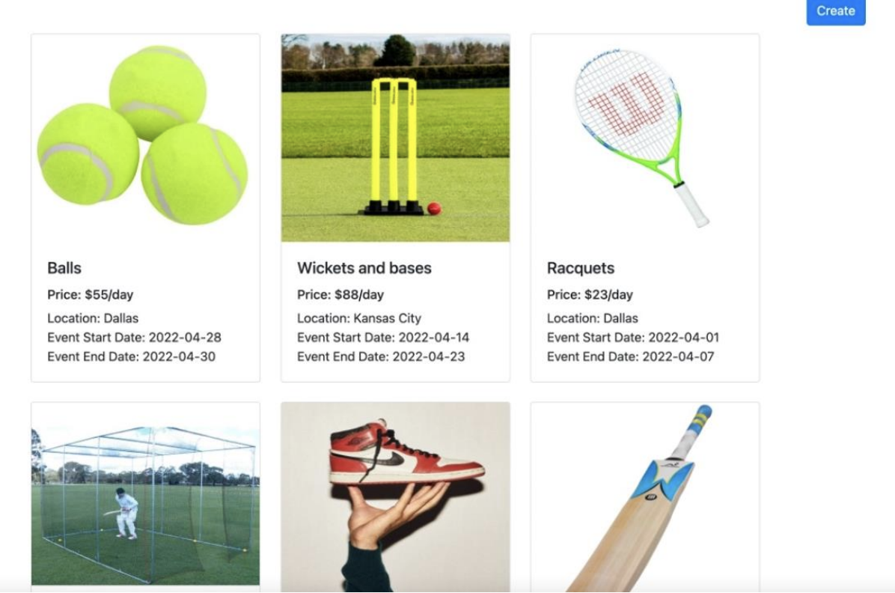
Lending a sport equipment

Slide 16
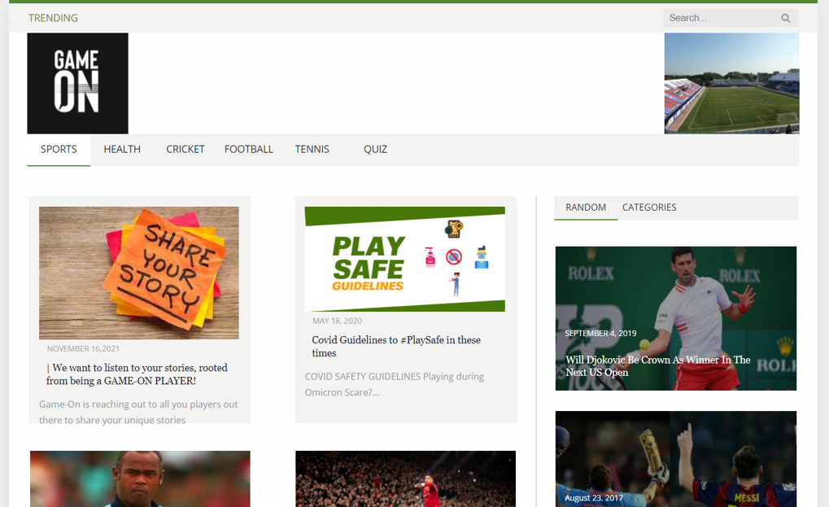
Blog Page with Search Feature
Fetch news with new API
User can search required blogs using search bar
Blogs contains following categories
Sports
Health
Ricket
Football
Tennis
Quiz

Slide 17
Feedback feature
User feedback is received with Formspree feature. It is a backend form, API and email administration for HTML structures. It is the simplest way to add custom contact us forms to your website

Slide 18

Thank You

